Slide 1
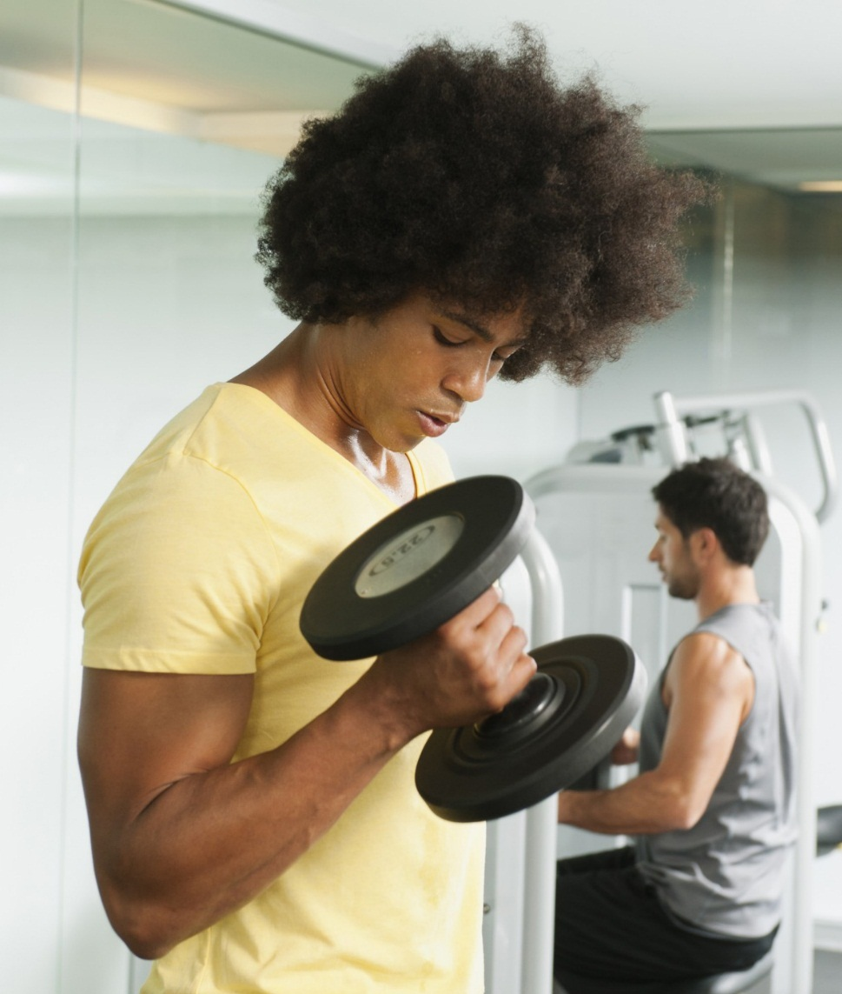


PHYSICAL HEALTH ACTIVITY TRACKER
phat

Slide 2
INTRODUCTION
Work out at home.
This PHAT app will help to track all your exercise, also create your own exercise and share it with the world. We believe fitness should be accessible to everyone and everywhere.

Slide 3
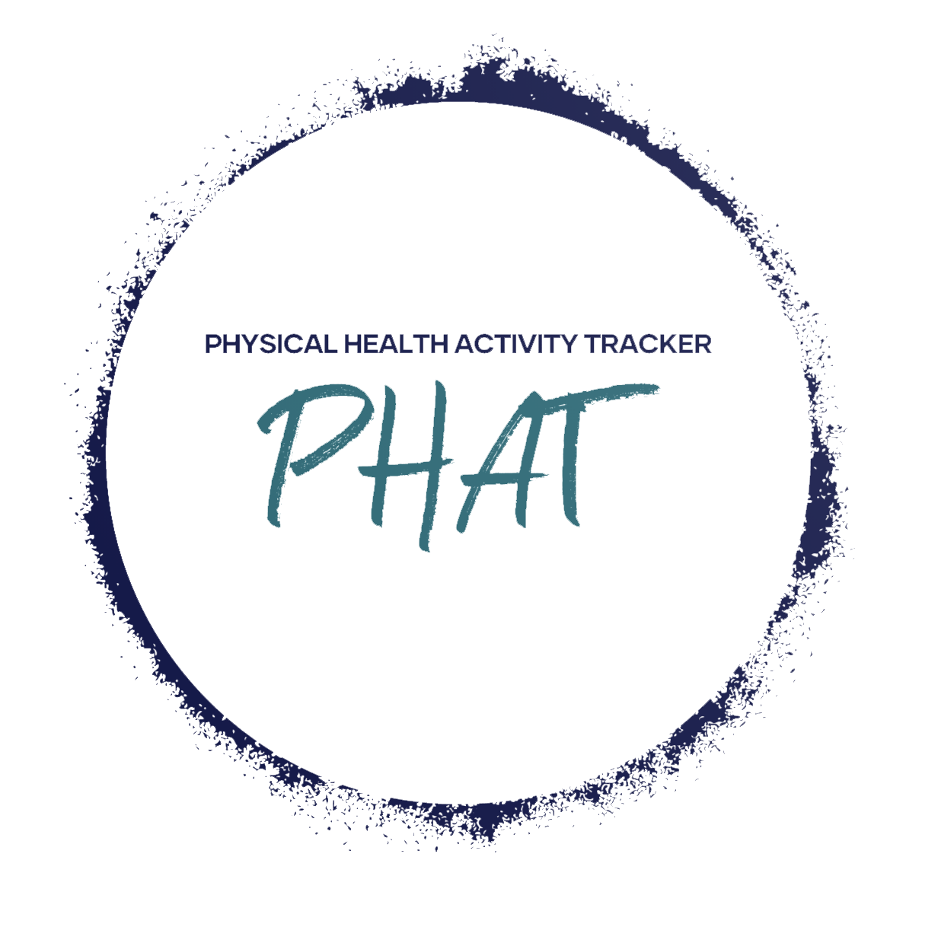
OUR FOCUS
FOR
People unsure on where to begin in curating their personal exercise regime
PHAT community to help each other reach their physical health and fitness goals
WE
Provide a timer for runners
Shows example exercises and workouts
Allow users to create and manage their own workout schedules

Slide 4
PRESENTATION

Slide 5
FUTURE DEVELOPMENT
Guide to healthier you / Nutrition
Calendar - Schedule
Calories burned/average bpm
Female / Male only pages
Login – Forgotten password
Mobile App
Wearable syncing/ tracking (Apple Watch, Samsung, Fit-Bit, etc.)
Factor into different body types (endomorph, ectomorph, mesomorph) could be an option prompted when taken to gender page. Between user profile and exercises.

